Slide 1
Isaac
Attached is the proposed interface for the business visionary competition in Period 2
There is almost no data!!!
There are notes at the end

Slide 2
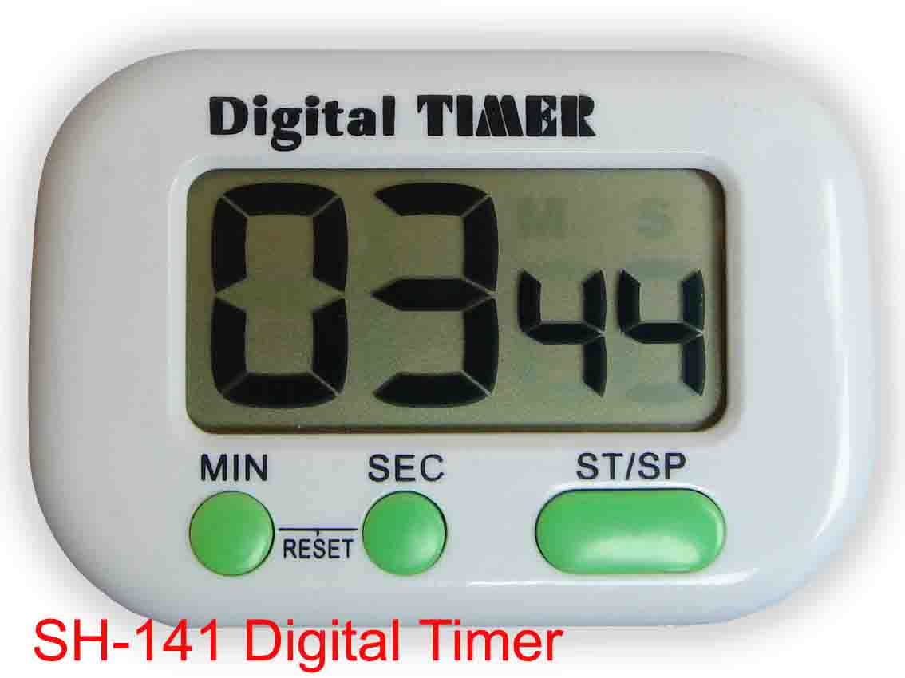
Visionary Competition
Note we can give a report on the
Relative influence
As a ranking for the business visionaries
Open to bid:
Influence Units
?
Transfer
VRKidEd
Time Offer
Player inputs time offer
Revenue $250,000
Pitch Cost: $50,000
Best fit niche: 1
Secondary niche: 2
Transfer
GovVR
Input Days
Live
Transfer
VRGames
MilitaryVR
√
Transfer
Decision Data from excel sheets
Transfer
AdEdVR
Transfer
VRCinema
Win or lose??
Calculated $
Calculated Time
SUBMIT
Remaining Sales Budget
Uncommitted Developer Time
Both the above were accumulated in the first negotiation

Slide 3
Notes
This is how I want it to work:
I want the Business Visionaries to appear in ‘random’ order one at a time – hence ‘live’ block
I think we need to include the ‘influence units’ either as units or as a ranking against other competitors
the time input works as follows:
When the BV comes up the minimum time appears in the time box. This can be adjusted by the players
To keep the competition exciting I think we need a timer or clock at GMT say
For each offer $30,000 is deleted from the sales budget – win or lose
For each WIN the time offer is taken off the development time availability
We need a way of telling people if they won or not

